Slide 1
Detail Types
People & Teams
employee: 👤 Mike
assignedTo: 👥 Team A
supervisor: 👔 John
shift: 🕐 Day
teamSize: 👨‍👩‍👧‍👦 Team: 5
Location & Movement
zone: 📍 Reefer Zone 3
location: 📍 Conference Room A
fromLocation: ⬅️ From: Zone A
toLocation: ➡️ To: Zone B
aisle: 🗺️ Aisle: 3-B
dock: 🚢 Dock: 2
Equipment & Assets
equipmentId: 🔧 Equipment: FL-003
vehicleId: 🚛 Vehicle: Forklift #5
machineStatus: ⚙️ Status: Running
assetTag: 🏷️ Asset: A-12345
Orders & Inventory
orderNumber: 📦 ON12345678
orderStatus: 📝 Order: Pending
inventoryLevel: 📉 Stock: Low
batchNumber: 🔢 Batch: B-2024-001
lotNumber: 🎫 Lot: L-789
Time & Urgency
cutoffMinutes: ⏱️ Cutoff in 11 min
timeRemaining: ⏰ Time remaining: 5 min
deadline: 🕐 Deadline: 2:00 PM
escalationLevel: ⚠️ Escalation: Level 2
slaMinutes: ⏳ SLA: 15 min remaining
Quantity & Volume
quantity: 📊 Qty: 150 units
weight: ⚖️ Weight: 250 lbs
volume: 📦📦 Volume: 50 cu ft
palletCount: 🗂️ Pallets: 12
Environmental
temperature: 🌡️ -18.5°C
humidity: 💧 Humidity: 65%
pressure: 🌪️ Pressure: Normal
lighting: 💡 Lighting: Adequate
Status & Condition
condition: ✅ Condition: Good
qualityStatus: ⭐ Quality: Pass
severity: 🔴 Severity: High
statusCode: 🏷️ Status: In Progress
Safety & Compliance
safetyLevel: 🦺 Safety: Required
complianceStatus: 📋 Compliance: Pending
incidentType: 🚨 Incident: Spill
certification: 🎓 Cert: Required
Communication & Escalation
notificationCount: 🔔 Notifications: 3
escalatedBy: 📢 Escalated by: System
priorityReason: 💬 Reason: Urgent
relatedTodoCount: 🔗 Related: 2 todos

Slide 2
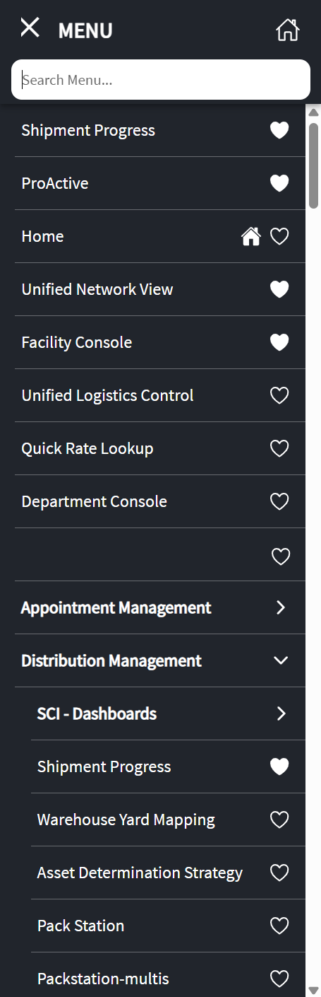
To Do List
To Do Types

